Slide 1

9

Slide 2
Introduction to Reverse Engineering
Ricardo Alanis, Luke Castro, Eric Rogers, Henry Wang, Jennifer Ward
Notes:
whoa

Slide 3
Reverse Engineering (of Software)
What is it?
Taking stuff apart and learning how it works. Specifically, we are taking apart programs.
What is it for?
Binary exploitation
Malware analysis
Other stuff
Binary exploitation
OG hacking. Way harder and cooler than web hacking.
But (mostly) kidding
A word on “hacking”...
Learn the technology
Sprinkle in some ingenuity

Slide 4
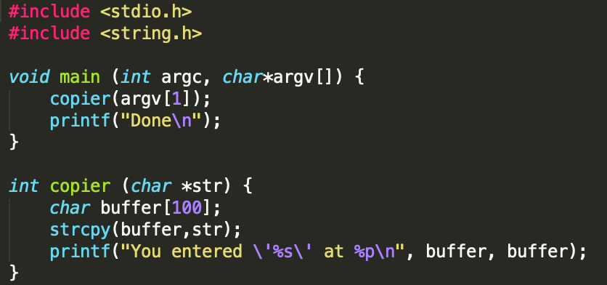
An Example
Notes:
Demo. “abcdefghijkl” echoes back. “Abcdefghijklm” crashes the program. <Random garbage> gives us root shell.
Can anyone tell us what the bug is here? What does it do? (Call on Dr. Sarac)

Slide 5
Basics

Slide 6
What is a Program?
A program is a collection of instructions that performs a specific task when executed by a computer.
At the lowest level, programs are a series of binary bits, 0 and 1.
C++ / Java Program
Compilation
Assembly Code (x86)
Translation
Machine Code (Binary)
Notes:
A program is a collection of instructions that performs a specific task when executed by a computer.
At the lowest level, programs are a series of binary bits, 0 and 1.
Programs are typically written initially in high-level programming languages such as Java, C++, and Python
These programs are then compiled into a low-level programming language called assembly.
Assembly code consists of a set of basic instructions that include operations to perform on locations in the computer’s memory called registers.
Assembly code is then translated into binary code which is directly processed by the CPU.

Slide 7
Numbering Systems
Base 10 (Decimal) - The representation of numbers we are most familiar with.
Each digit (0-9) is a product of a power of 10, for example:
6197 = 7 x 10⁰ + 9 x 10¹ + 1 x 10² + 6 x 10³ = 7 x 1 + 9 x 10 + 1 x 100 + 6 x 1000 = 6197
Base 2 (Binary) - The representation of numbers processed by computers.
Each digit (0 and 1) is a product of a power of 2, for example:
1011 = 1 x 2⁰ + 1 x 2¹ + 0 x 2² + 1 x 2³ = 1 x 1 + 1 x 2 + 0 x 4 + 1 x 8 = 11
Base 16 (Hexadecimal) - The representation of numbers used by programmers to represent long binary numbers concisely.
Contains 0 - 9 and A - F as digits where each is a product of a power of 16. For example:
0xC5 = 5 x 16⁰ + 12 x 16¹ = 5 + 192 = 197
Note: Many times hexadecimal numbers are preceded by “0x” to denote their base.
Notes:
5 = 5 x 10⁰ = 5 x 1 = 5
12 = 2 x 10⁰ + 1 x 10¹ = 2 x 1 + 1 x 10 = 2 + 10 = 12

Slide 8
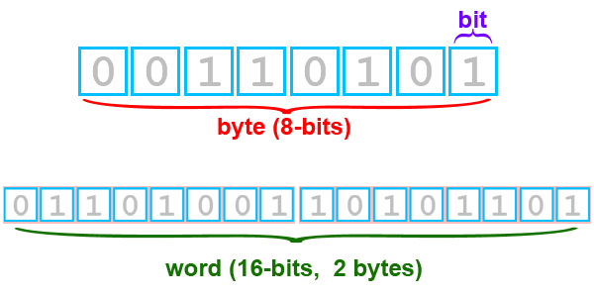
Bits, Bytes, and Words
A bit is a single binary digit, 0 or 1.
A byte is a group of eight bits.
For example, 00110101 = 0x35
A word is a group of 2 bytes, or 16 bits.
For example, 0110100110101101 = 0x69AD
A dword, commonly used in assembly code, is just two words.
Notes:
dword = 32-bit integer

Slide 9
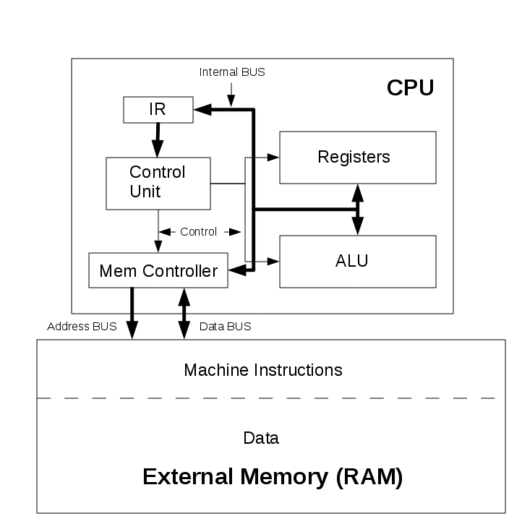
CPU Memory Layout
Registers are the smallest data holding elements built into the processor (CPU)
Registers hold the instructions or operands that are currently being accessed by the CPU
Primary memory (RAM) are data holding elements, located outside of the CPU
RAM holds the data that the CPU will require for processing

Slide 10
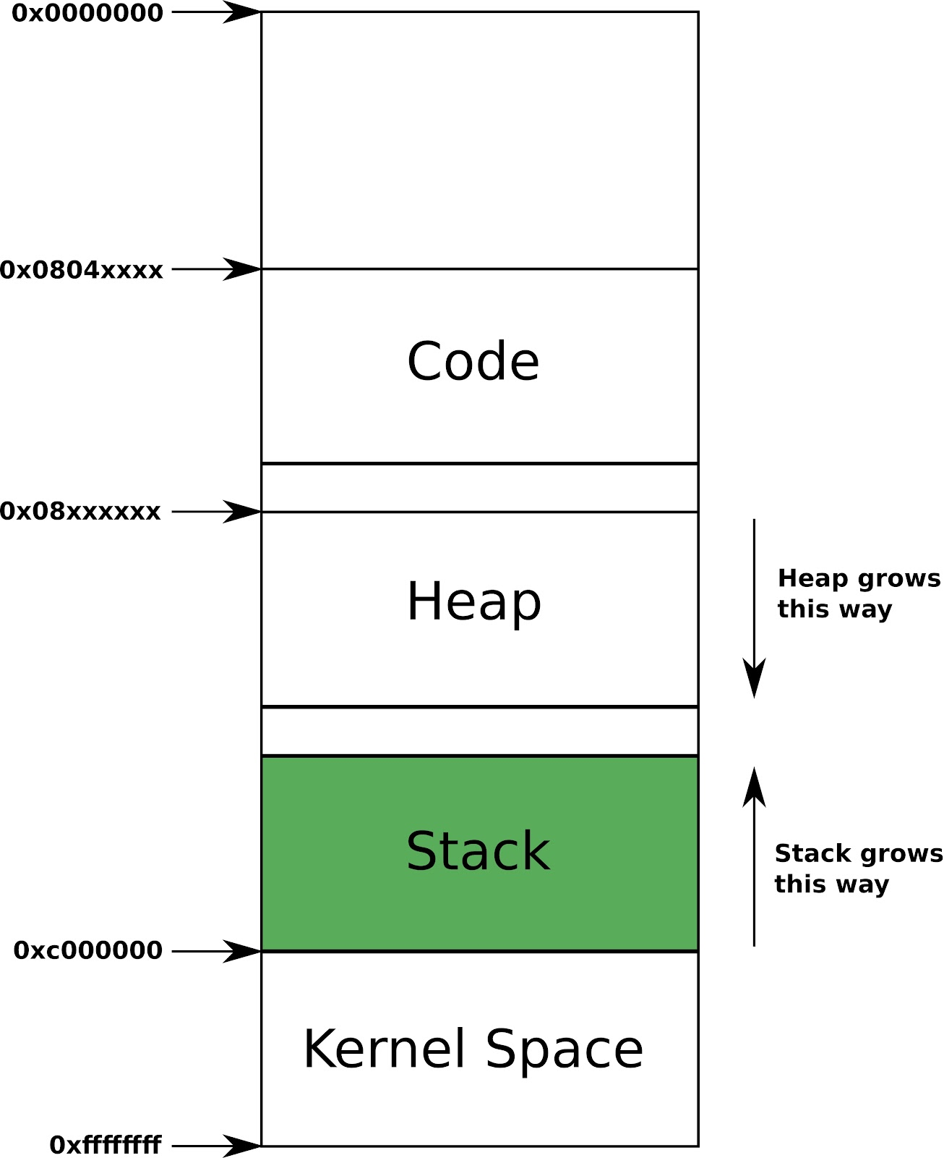
Memory Layout of a C Program
Low Memory Address
Text (Code) - Contains the machine code of the compiled program
Heap - During execution, dynamic memory is created (allocated) here and eliminated (freed) when it is no longer needed by the program
Stack - Stores all local variables and is used for passing arguments to functions, along with the function’s return address. Last-in-First-Out
High Memory Address

Slide 11
Little and Big Endianness
Little Endian and Big Endian are two ways of storing multi-byte data-types in computers. They differ in where they store the most significant (first) byte of the data:
Little Endian - the last byte of the binary data-type is stored first
Big Endian - the first byte of the binary data-type is stored first
Example with 0x12345678
Little Endian:
Big Endian:
78 56 34 12
12 34 56 78

Slide 12
X86 Assembly

Slide 13
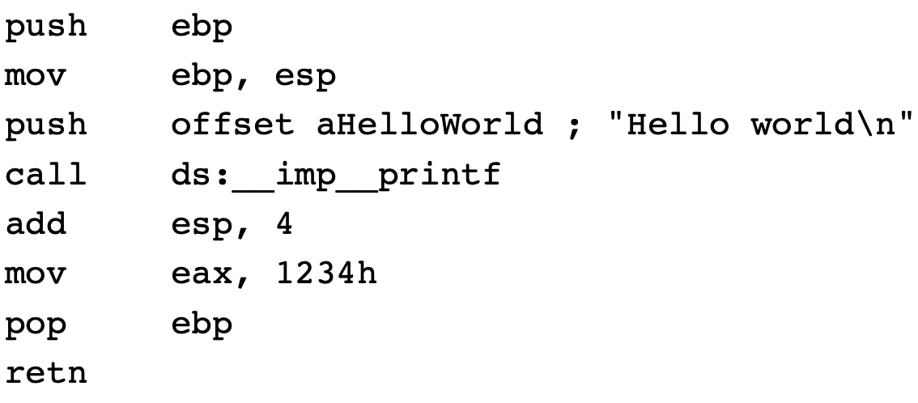
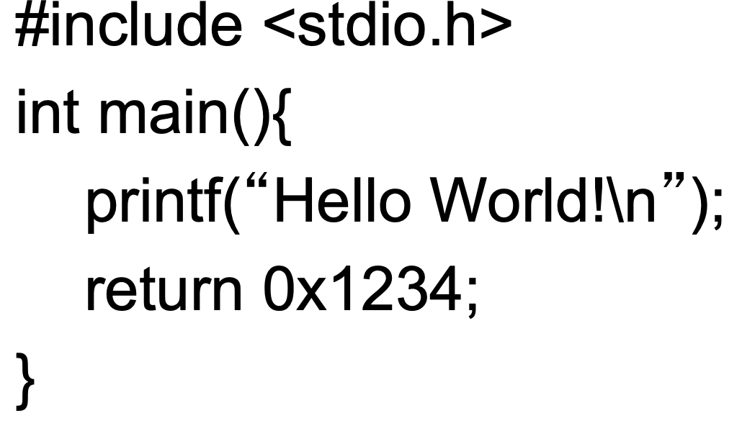
ASM
Lowest-level programming language

Slide 14

Intel vs AT&T
Intel
<instruction> <destination>, <operand(s)>
No special formatting for immediate values and registers
mov eax, 0xca
SIZE PTR [addr + offset] for value at address
add DWORD PTR [ebp-0x8], 0x5
AT&T
<instruction> <operand(s)>, <destination>
$ designates immediate value, % designates registers
movl $0xca, %eax
Offset(addr) for value at address
addl $0x5, -0x8(%ebp)

Slide 15
Registers
Bytes—8 bits. Examples: AL, BL, CL
Word—16 bits. Examples: AX, BX, CX
Double word—32 bits. Examples: EAX, EBX, ECX
Quad word—64 bits. Not found in x86 architectures but instead combines two registers usually EDX:EAX.

Slide 16
Registers
EAX - Stores function return values
EBX - Base pointer to the data section
ECX - Counter for loop operations
EDX - I/O pointer
EFLAGS - holds single bit flags
ESI - Source pointer for string operations
EDI - Destination pointer for string operations
ESP - Stack pointer
EBP - Stack frame base pointer
EIP - Pointer to next instruction to execute (“instruction pointer”)

Slide 17
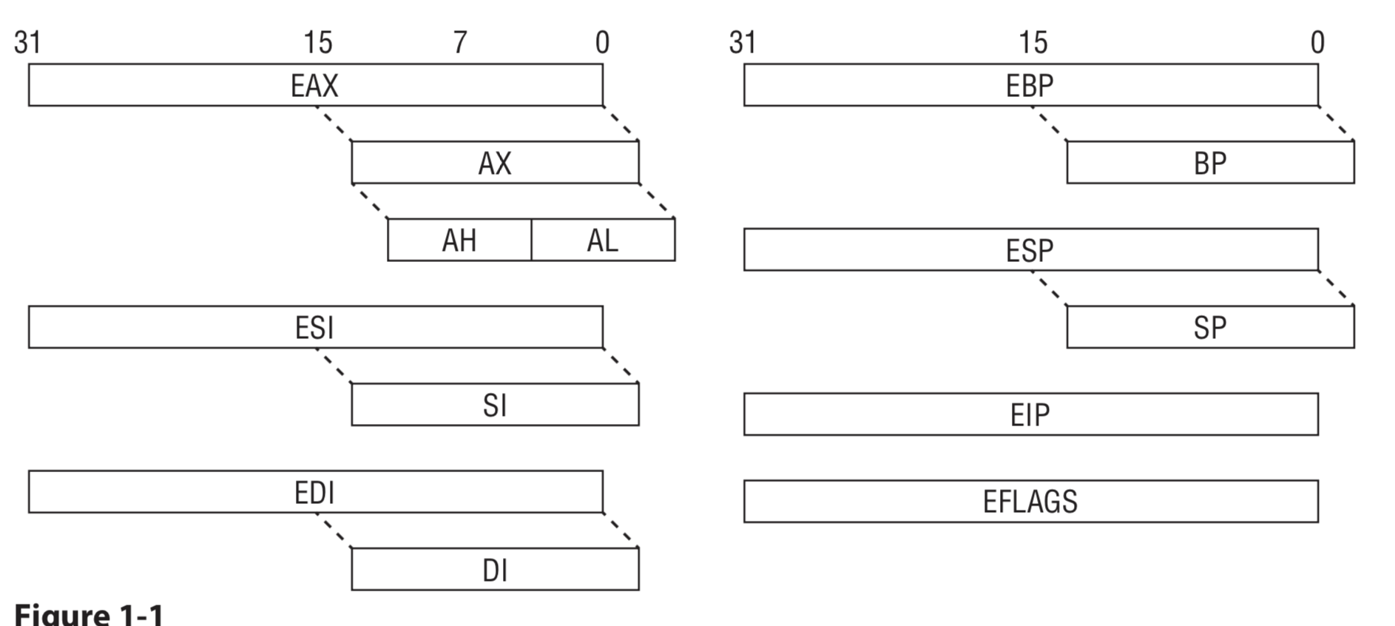
Evolution of Register

Slide 18
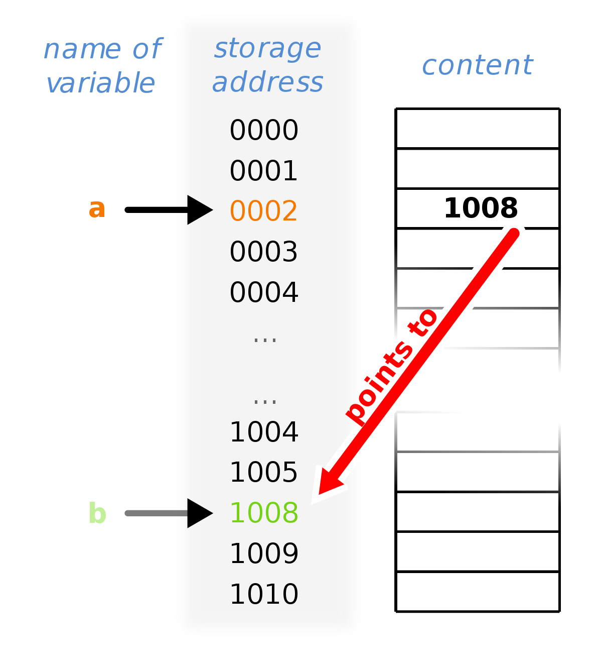
x86 Instructions
mov eax, edx : move contents of edx into eax
mov eax, SIZE PTR [edx] : move contents to which edx points into eax
Similar to pointer dereference in C/C++ eax = *edx [ ] -> dereference address between the brackets L1 db "word", 0 mov al, [L1] - al holds “w”
mov al, L1 - al holds lower byte address L1
mov eax, DWORD PTR [a] mov eax, DWORD PTR [eax]
eax now contains value of variable “b”

Slide 19
x86 Instructions continued
add eax, 0x5 : stores value in eax
sub eax, 0x5 : stores value in eax
mul eax, edx : stores value in edx:eax
div eax, edx : stores dividend in eax, remainder in edx
inc edx: increments edx by 1
dec ecx: decrements edx by 1
cmp eax, 0x10: compare eax with 0x10, set flags
Notes:
add lea

Slide 20
x86 Instructions continued
jmp loop : jump to the label “loop”
je loop : jump to “loop” if previous cmp’s two operands are equal
jne loop : jump to “loop” if previous cmp’s two operands are not equal
jg loop : jump to “loop” if first operand is greater than second operand
jl loop: jump to “loop” if first operand is less than second operand
jge loop: jump to “loop” if first operand is greater than or equal second operand
jle loop: jump to “loop” if first operand is less than or equal second operand

Slide 21
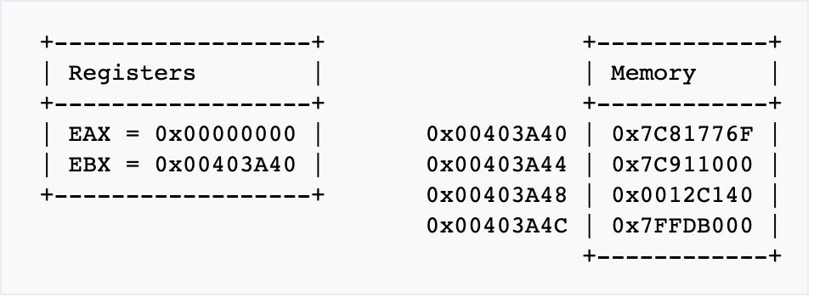
x86 Instructions - lea (load effective address)
Example:
lea eax, [ebx+8]: loads effective address of [ebx+8] into eax
eax now equals 0x00403A48.
In contrast, the mov instruction mov eax, [ebx+8] would result in
eax = 0012C140.

Slide 22
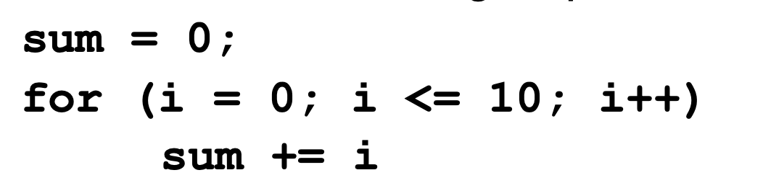
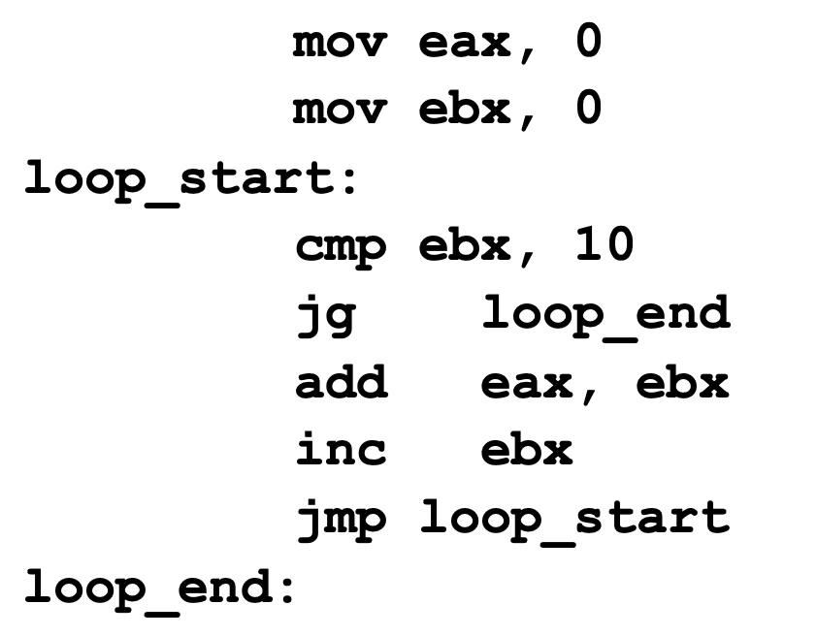
cmp, jmp - In action
eax will hold sum
ebx will hold i
Compare i with 10
If i greater than jump to the loop_end
Else add i to sum
Increment i
Jump back to start of loop
Notes:
NOte the jg and <=

Slide 23
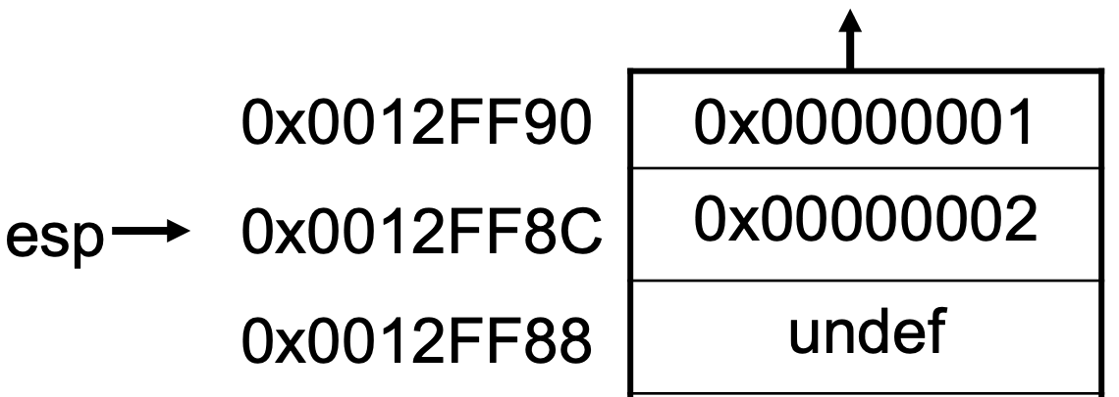
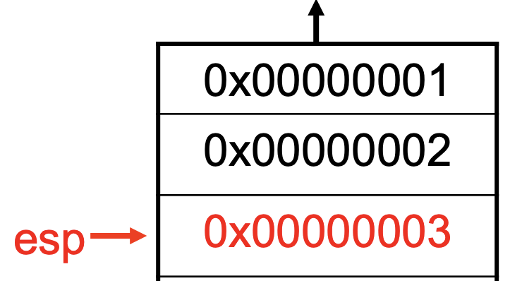
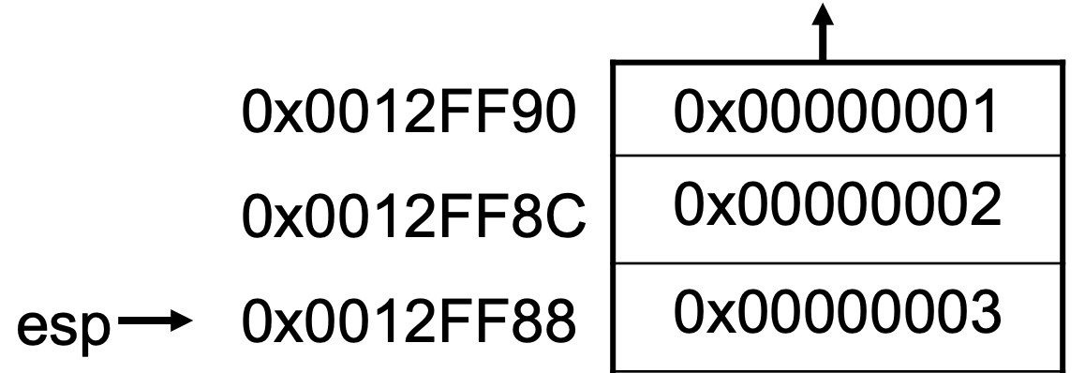
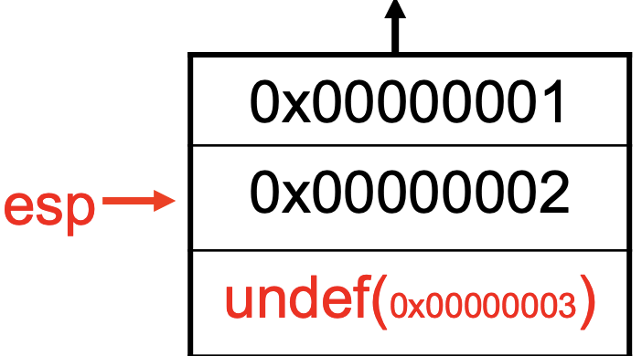

x86 Instructions continued
push - “Pushes” DWORD onto Stack. decrements the stack pointer, esp, by 4 bytes
eax 0x00000003 push eax
pop - “pops” DWORD off Stack onto a register. Increments the stack pointer, esp, by 4 bytes.
eax 0xFFFFFFFF pop eax
eax 0x00000003

Slide 24
x86 Instructions continued
Calling/Conditional instructions
call 0x8004bc : load address of next instruction onto stack, then jumps to the function at address 0x8004bc
ret : restores next address of previous function (in EIP) and jumps to that value
Notes:
Put PICTURES here

Slide 25
push, pop, mov, add - In action
Push stack frame
Move current stack frame
Push “Hello world” onto stack for parameter to call
Call print function
Add 4 to stack pointer
Move 1234h into eax
Pop old stack frame pointer return
Return to next instruction
Notes:
EAX holds return value

Slide 26


Static Analysis
Notes:
Connect assembly to static analysis

Slide 27
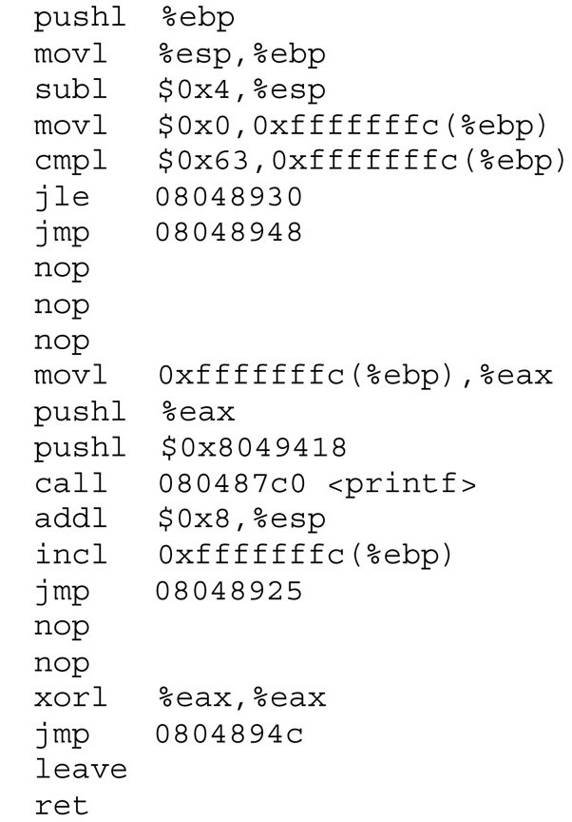

What is Static Analysis ?
Analyzing the code and structure of a program without actually running the program.
Notes:
Segway into strings

Slide 28
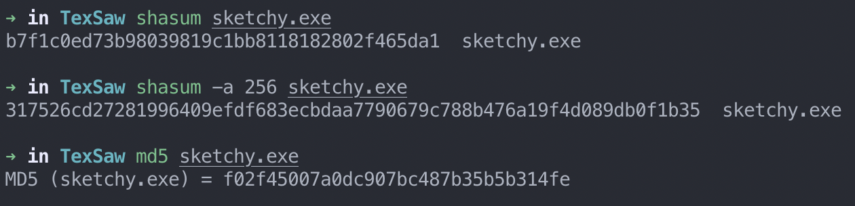
What are you analyzing ?
paint.exe ? sketchy.exe ?
Integrity - make sure the program you download/run is the one the trusted source created.
Hash it ! Check it on VirusTotal. Verify.
Tools to use:
shasum
md5
Notes:
mark for deletion

Slide 29
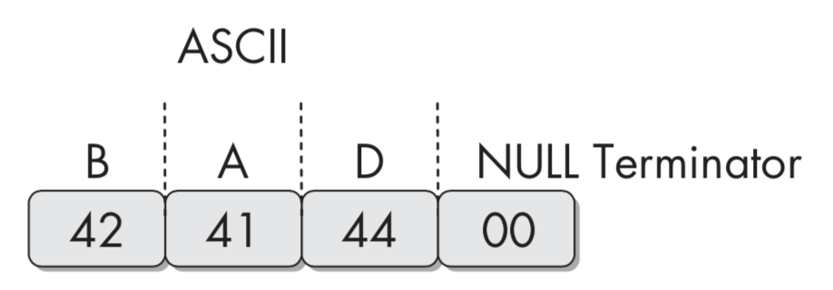
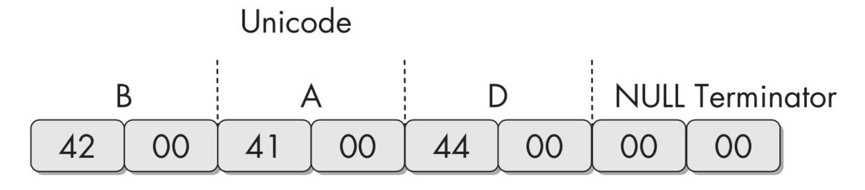
Strings
“Any word or phrase is a string just like this one”
Searching through the strings can be a simple way to get hints about the functionality of a program.
Strings can gives you:
URLS
PASSWORDS
Standard library calls
*Diagrams from Practical Malware Analysis

Slide 30
Strings: Tools
GNU Strings:
ASCII
UNICODE: UTF-16LE, UTF-16BE, UTF-32LE, UTF-32BE
FLOSS:
More powerful String finder: Obfuscated Strings (purposely garbled strings)
ASCII , UTF-16LE

Slide 31
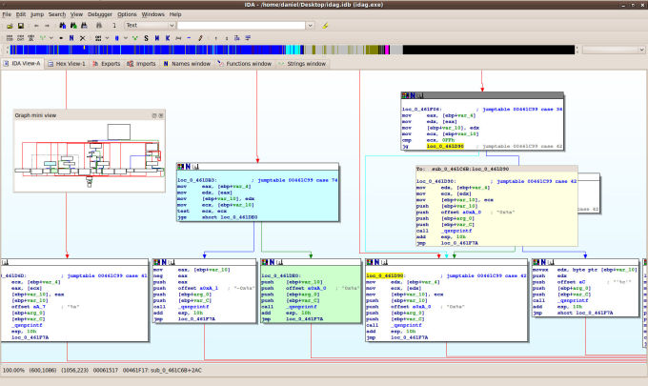
Decompilers
Turning 01’s into readable Assembly Language
Useful for analyzing a program’s structure and procedures.
Tools used:
Ghidra
IDA Pro
Binary Ninja
Radare2
Notes:
go into ghidra demo

Slide 32
Dynamic Analysis

Slide 33
What is Dynamic Analysis
The analysis of a program while it is running, to observe its true functionality
This allows you to view the transfer of state within a program
Dynamic Analysis should be performed after static analysis has been completed (or it is too hard to complete).

Slide 34

Tools
Linux: GDB, Immunity Debugger, strace, ltrace
Windows: OllyDBG, WinDBG, Dr. Memory, DynamoRIO
Notes:
Strace
What’s a system call - bottom, lowest layer that sits between your program and OS
Ltrace
Looks at Library calls i.e. C-Standard library, what you will see in L trace you see in S trace
DynamoRIO - Framework for Dynamic Analys - Windows equivalent of ltrace and strace
Dr. MEmory built on DynamoRIO

Slide 35
GDB Walkthrough - GEF
Command line interface
Step through programs
View stack
Jump through memory addresses
GDB Cheat Sheet !
Notes:
GDF GEF demo - Ricardo

Slide 36
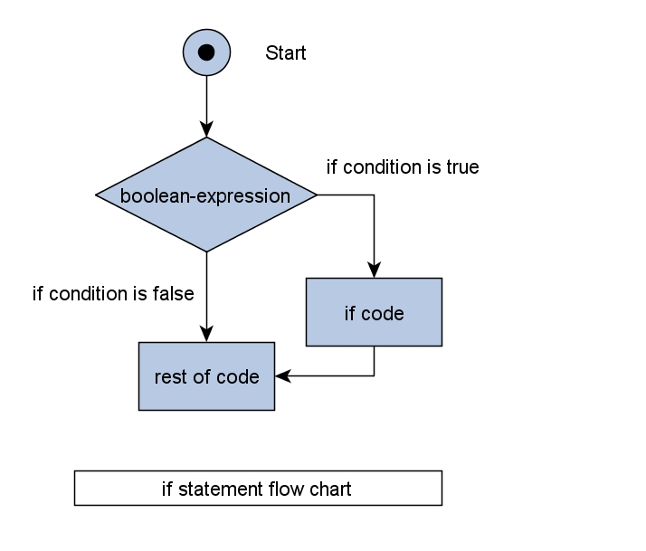
Dynamic Analysis Limitations
Not all functionalities may execute when a program is run
Command line arguments
Branches in code

Slide 37


Dynamic Analysis and Malware
Dynamic analysis techniques on malware can put your system and network at risk!
Virtual Machines and Sandboxes allow dynamic analysis on malware
Cuckoo Sandbox
Virtualbox/VMWare

Slide 38
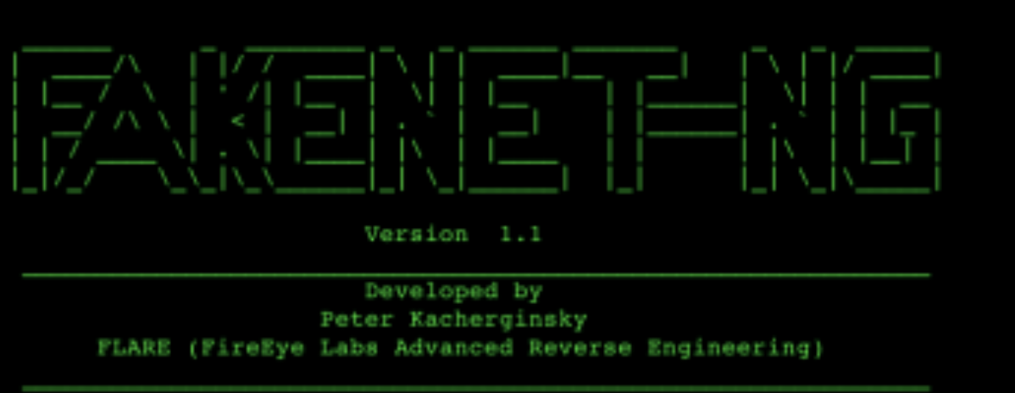


Basic Dynamic Analysis on Malware
Process Monitoring
Top
Virtual Networking
FakeNet-NG / INetSim
Network Traffic Logging
WireShark
NetCat

Slide 39
Buffer Overflow Exploitation
Notes:
intro with variable overwrite demo

Slide 40
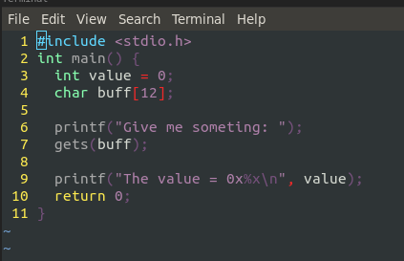
Buffer Overflow - variable overflow

Slide 41
Buffer Overflow
Putting more data into a buffer than there is space allocated
Changes program flow, sends stack pointer (SP) to another address

Slide 42
Buffer Overflow
Four possibilities, IP is sent:
to a virtual address that isn’t mapped to a physical address
to a protected address (kernel)
to an address that has no executable instruction (NOP)
to an address that contains an instruction

Slide 43
Buffer Overflow

Slide 44
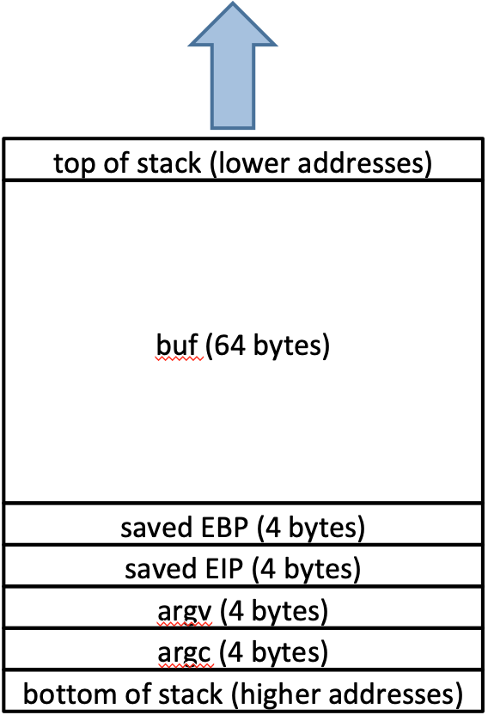
Exploit Overview
int copier (char *str) {
char buffer[100];
strcpy(buffer, str);
printf(“You entered \’%s\ at %p\n”, buffer, buffer);
} // end function copier
buffer[100]
Notes:
The vulnerability is in the function copier(). It takes in a character array and stores it in a buffer of size 100, but it doesn’t check if the array can fit into the buffer. The strcpy() call will be the main focus of the exploit.

Slide 45
Exploit Overview
int copier (char *str) {
char buffer[100];
strcpy(buffer, str);
printf(“You entered \’%s\ at %p\n”, buffer, buffer);
} // end function copier
NOP sled: 909090909090909090909090909090909090909090909090909090909090909090909090
<shellcode>
padding: aaaaaaaaaaaaaaaaa
aaaaaaaaa
<return address into NOP sled>
Notes:
The vulnerability is in the function copier(). It takes in a character array and stores it in a buffer of size 100, but it doesn’t check if the array can fit into the buffer. The strcpy() call will be the main focus of the exploit.

Slide 46
“Advanced” Topics

Slide 47
Other Attacks
The attack we saw earlier is outdated.
Some other attacks you may want to google on your own time:
Printf arbitrary read/write
Heap overflow
Data leakage

Slide 48
More Stuff To Google
Protections
Non-executable Stack
Address Space Layout Randomization (ASLR)
Stack Canaries
...And Circumventing Those Protections
NOP-sledding
Data leakage
Return-to-libc attack
ROP chaining

Slide 49
Takeaway
A stack overflow attack is just one (classic) example of exploiting program logic to do cool stuff.
Hacking is about learning the rules and coming up with a neat way to do unexpected things within those rules.
The example we showed today is just that: one example. Exploitation of logic flaws can take countless forms.
Get familiar with how stuff works and you’ll be ready to start hacking!

Slide 50
9

